Slide 1


Team:
Jessica Martinez
Mohammed Saad
Scott Murray
Team:
Jessica Martinez
Mohammed Saad
Scott Murray

Slide 2
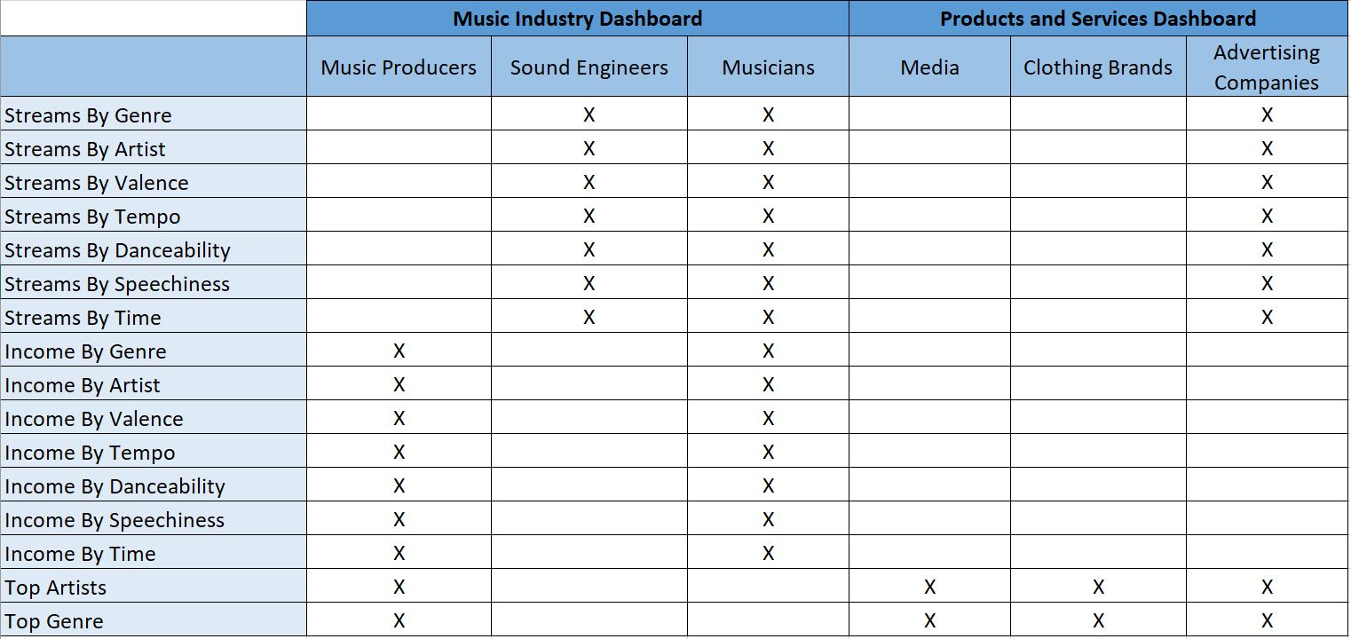
Dashboards and KPIs

Slide 3
Tableau
Tableau Dashboard: https://10ay.online.tableau.com/#/site/csusbscm649/workbooks/576423/views
Top Artists by Income - Client: Music Producers, Media, Clothing Brands, Advertising
Top Streaming Artists (2017, 2018, & Comibined) - Client: Sound Engineers, Musicians, Advertising

Slide 4
Power BI
Power BI Dashboard: https://app.powerbi.com/groups/f56e70ce-374c-472a-9e9f-9a2e4b73d4ce/reports/809e2755-f0e7-4fa9-a6a3-efb9a6671071?ctid=d73b9eaa-07c9-47c4-a6ce-f13bee0e8117
Relating multiple datasets
Regression Analysis

Slide 5
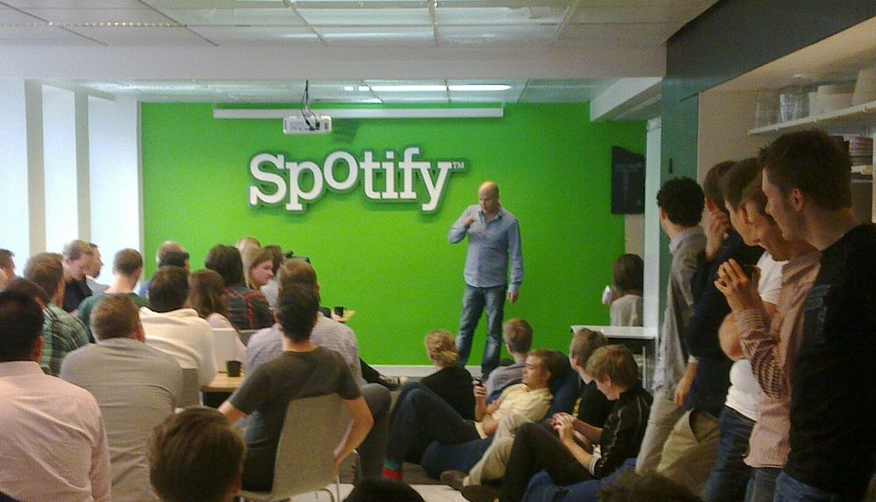




Thank You Questions?

